Slide 1
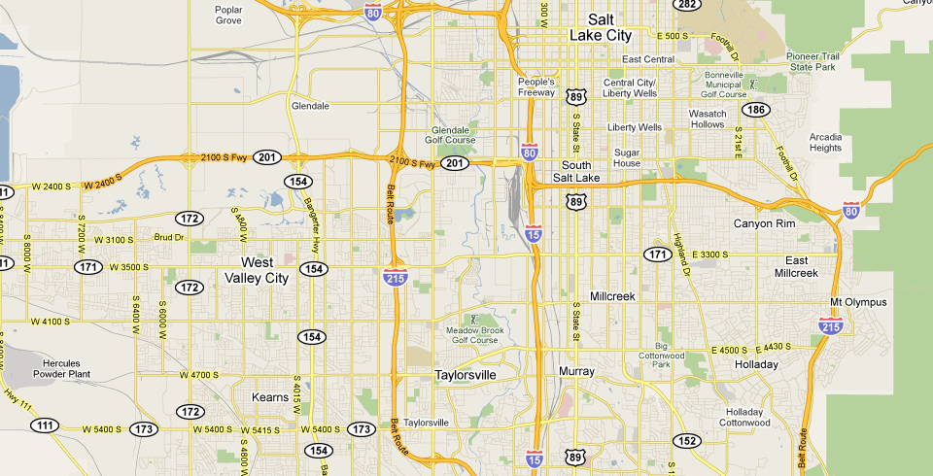
Cell Tower Mapping
37.765299 -122.026968
37.671806 -121.859375
37.671806 -121.859375
37.671806 -121.859375
37.671806 -121.859375
Salt Lake Region
Suspect
Cell Tower

