Slide 1
Cell Phone Investigations
Coverage Contraction
E911 or “Pinging”
Coverage Expansion
Selection
Selection
Explained
Per Call Measurement

Slide 2
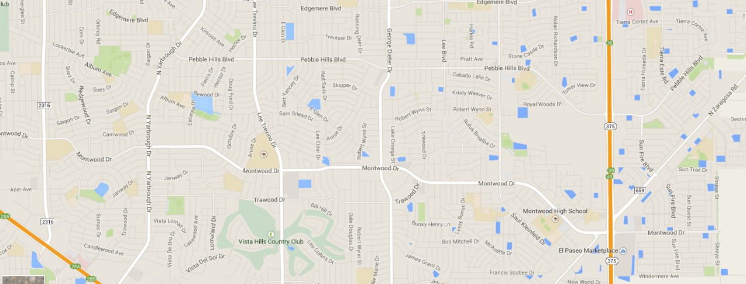
Cell Phone Tower – Coverage Contraction
As cellphone usage INCREASES on a given tower, the coverage or effective range of that tower, DECREASES

Slide 3
Cell Phone Tower – Coverage Expansion
As cellphone usage DECREASES on a given tower, the coverage or effective range of that tower, INCREASES

Slide 4
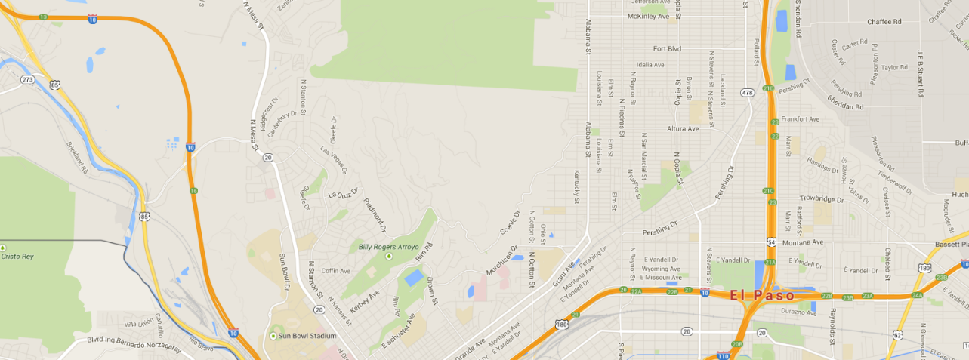
Cell Phone Towers – Selection
2.14 Miles
.72 Miles
A cell phone will NOT NECESSARILY connect to the CLOSEST tower

Slide 5
Cell Phone Towers – Selection
2.14 Miles
Radio signal blocked by mountain range
A cell phone will NOT NECESSARILY connect to the CLOSEST tower

Slide 6
Per Call Measurement Data

Slide 7
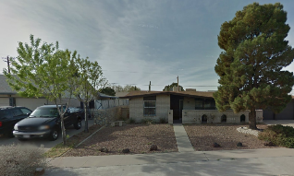
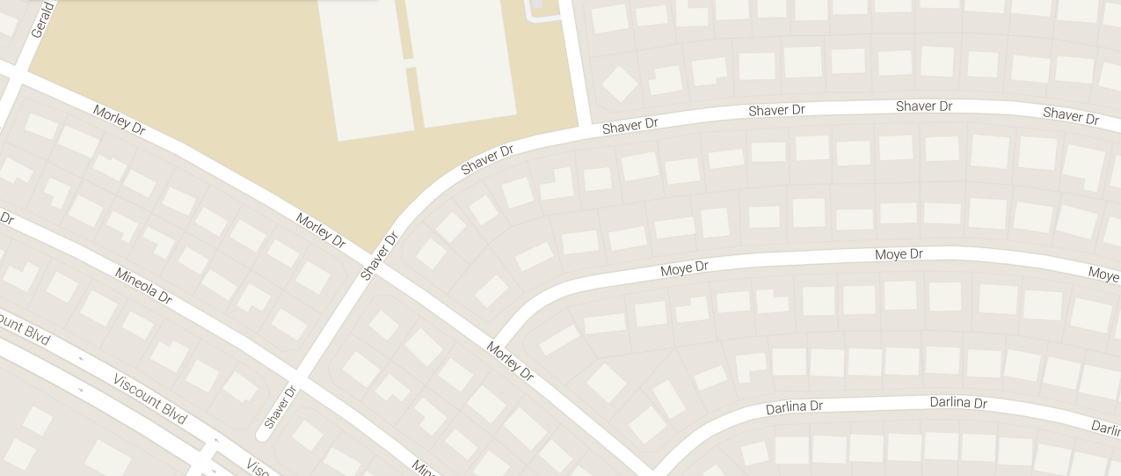
E911 or “Pinging”
31.780142, -106.375576
31.780484, -106.379286
31.780105, -106.375665
31.780269, -106.375391
31.780525, -106.375563
A cell phone will NOT NECESSARILY connect to the CLOSEST tower
Click once to see the activation of several “pings”. Each has a “simulated”15 minutes interval

