Slide 1
Mexican Drug Cartels

Slide 2
Mexican Drug Cartels - Paths
Power and Influence
1970
1975
1980
1985
1990
1995
2000
2005
2010
Tijuana Cartel
Juarez Cartel
Gulf Cartel
Sinaloa Cartel

Slide 3
Mexican Drug Cartels – Screen Tips
Power and Influence
Sinaloa and the Pacific
Gulf under
Pressure
Rise of Sinaloa
Cocaine
Beginnings
Leadership
Losses
Gulf and
NE Mexico
1970
1975
1980
1985
1990
1995
2000
2005
2010
Tijuana Cartel
Juarez Cartel
Gulf Cartel
Sinaloa Cartel

Slide 4
Mexican Drug Cartels - Images
Power and Influence
Sinaloa and the Pacific
Gulf under
Pressure
Rise of Sinaloa
Beginnings
Leadership
Losses
Gulf and
NE Mexico
1970
1975
1980
1985
1990
1995
2000
2005
2010
Tijuana Cartel
Juarez Cartel
Gulf Cartel
Sinaloa Cartel

Slide 5
Mexican Drug Cartels – Interface
Power and Influence
Tijuana
Cartel
Overview
Juarez
Cartel
Overview
Gulf
Cartel
Overview
Sinaloa
Cartel
Overview
Return to
Main Graph
1970
1975
1980
1985
1990
1995
2000
2005
2010
Tijuana Cartel
Juarez Cartel
Gulf Cartel
Sinaloa Cartel

Slide 6
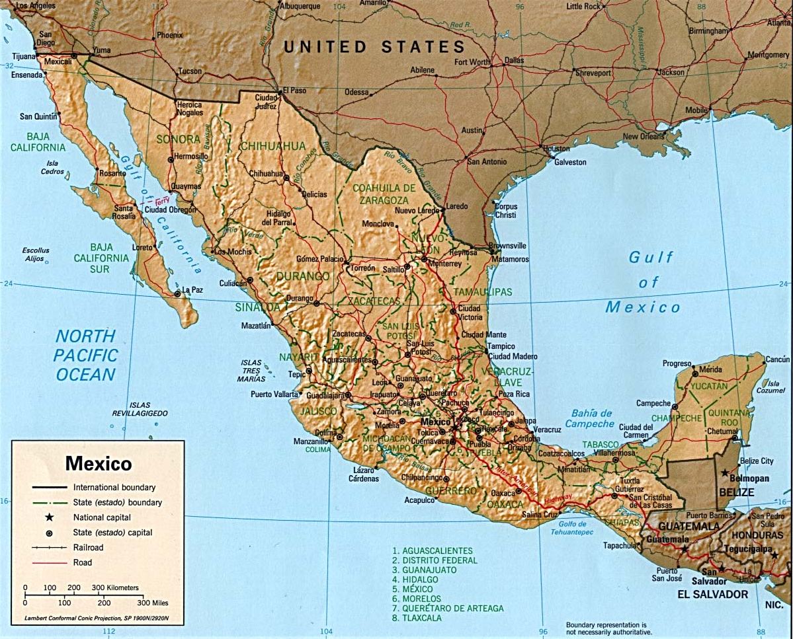
Tijuana Cartel
Return to
Main Graph
History
Cultural
Current Trends

Slide 7
Juarez Cartel
Return to
Main Graph
History
Cultural
Current Trends

Slide 8
Gulf Cartel
Return to
Main Graph
History
Cultural
Current Trends

Slide 9
Sinaloa Cartel
Return to
Main Graph
History
Cultural
Current Trends

