Slide 1
Ian Thomson Incident #123-123-43, Port Colborne, ON
Overview
Attack Animation
Assailant Approach 1
“Castle Doctrine”
US Law
Arson Suspects
Composite Video
Assailant Approach 2
Bill C-60
(Died Parliament on 26 March 2011)
Ian Thomson
Attack
Timeline
First
Molotov
Area Map
Residence Video
Second
Molotov
Residence Map
Third
Molotov

Slide 2
Ian Thomson, 53, Port Colborne, Ont.
Charged with careless use of a firearm and pointing a firearm and two counts of careless storage of a firearm. August 2010

Slide 3
Suspects charged with arson in the Thomson Case
Photo Unavailable
Photo Unavailable
Photo Unavailable
Randy Weaver, 48, of Port Colborne, arson in December, “intentionally set the home on fire while the homeowner was inside.”
Justin Lee, 19, of Welland, with arson
Richard Coulthearst, 46, Coulthearst
Photo Unavailable
Michael Theberge, 20, of Port Colborne

Slide 4
Case Overview, Aug. 22, 2010
Ian Thomson
House attacked by 3 masked men
3 Molotov cocktails
Recorded by surveillance cameras
Thomson responded with gun fire
2-3 shots
Thomson presented Crown with video
Thomson charged criminally
4 suspects charged with arson
Thomson’s charges reduced and pending

Slide 5
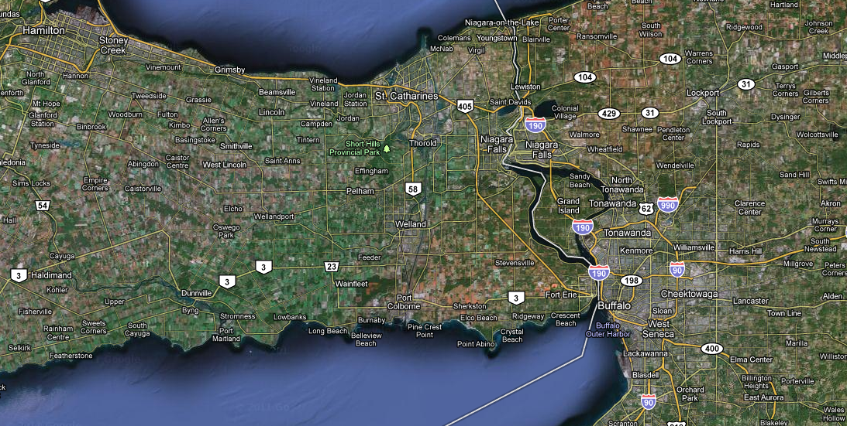
General Area Map
http://maps.google.com Port Colborne, ON searched on 5-11-2001

Slide 6
Ian Thomson Residence, 3499 Snider Rd., Port Colborne

Slide 7
Ian Thomson Residence, 3499 Snider Rd., Port Colborne

Slide 8
Attack Animation
Click to start animation
1st click – starts attack
2nd click – fire attack

Slide 9
Media Reaction
http://news.nationalpost.com/2011/01/20/man-faces-jail-after-protecting-home-from-masked-attackers/

Slide 10
Composite Video
http://www.youtube.com/watch?v=dyiqCkgGDCQ

Slide 11
Attack Video 1 – Approach

Slide 12
Attack Video 2 – Approach 2

Slide 13
Attack Video 3 – First Molotov

Slide 14
Attack Video 4 – Second Molotov

Slide 15
Attack Video 5 – Third Molotov

Slide 16
Castle Doctrine, US Law
A Castle Doctrine (also known as a Castle Law or a Defense of Habitation Law) is an American legal doctrine arising from English common law^{[1]} that designates one's place of residence (or, in some states, any place legally occupied, such as one's car or place of work) as a place in which one enjoys protection from illegal trespassing and violent attack. It then goes on to give a person the legal right to use deadly force to defend that place (his "castle"), and any other innocent persons legally inside it, from violent attack or an intrusion which may lead to violent attack.
In a legal context, therefore, use of deadly force which actually results in death may be defended as justifiable homicide under the Castle Doctrine.
An intruder must be making (or have made) an attempt to unlawfully and/or forcibly enter an occupied residence, business or vehicle.
The intruder must be acting illegally—e.g. the Castle Doctrine does not give the right to attack officers of the law acting in the course of their legal duties
The occupant(s) of the home must reasonably believe that the intruder intends to inflict serious bodily harm or death upon an occupant of the home
The occupant(s) of the home must reasonably believe that the intruder intends to commit some other felony, such as arson or burglary
The occupant(s) of the home must not have provoked or instigated an intrusion, or provoked or instigated an intruder to threaten or use deadly force

Slide 17
Bill C-60, The Citizen's Arrest and Self-Defence Act (pending) http://www.parl.gc.ca/About/Parliament/LegislativeSummaries/bills_ls.asp?ls=c60&source=library_prb&Parl=40&Ses=3&Language=E
Bill C-60, An Act to amend the Criminal Code (citizen’s arrest and the defences of property and persons) (short title: Citizen’s Arrest and Self-defence Act), was introduced and received first reading in the House of Commons on 17 February 2011. It received second reading on 22 March 2011, and died on theOrder Paper when Parliament was dissolved on 26 March 2011. The bill amends the Criminal Code (Code)1 to enable persons who own or have lawful possession of property, or persons authorized by them, to arrest a person they find committing a criminal offence on or in relation to that property, within a reasonable time. The bill also amends the Code to simplify the provisions relating to the defences of property and persons.
1.1 The Current Law in Canada
1.1.1 Self-defence
In Canada, the law of self-defence has been codified in sections 34 to 37 of the Criminal Code. These sections set out the different circumstances in which a private citizen may defend himself or herself or another person against unlawful attack.
Section 34 of the Code defines the extent to which force is justified in repelling an unprovoked assault. Section 34(1) is a general defence that can be employed only by non-aggressors who never intend to cause grievous bodily harm or death through their actions. This section requires that the following four elements be established by a person accused of using force against another person:
The accused was unlawfully assaulted.
The accused did not provoke the assault.
The force used by the accused was not intended to cause death or grievous bodily harm.
The force used by the accused was no more than was necessary to defend himself or herself.

Slide 18
Attack Timeline (Based on available video)
6:36:13
Three assailants arrive
6:36:28
Three assailants are seen on driveway
6:36:59
First Molotov cocktail is thrown; back of house is set on fire
6:37:34
Second Molotov cocktail is thrown; dog kennel is set on fire
6:38:01
Third Molotov cocktail is thrown; side of house is set on fire

