Slide 1
Couch and Cash Case – Photos
by Thomas Manson

Slide 2
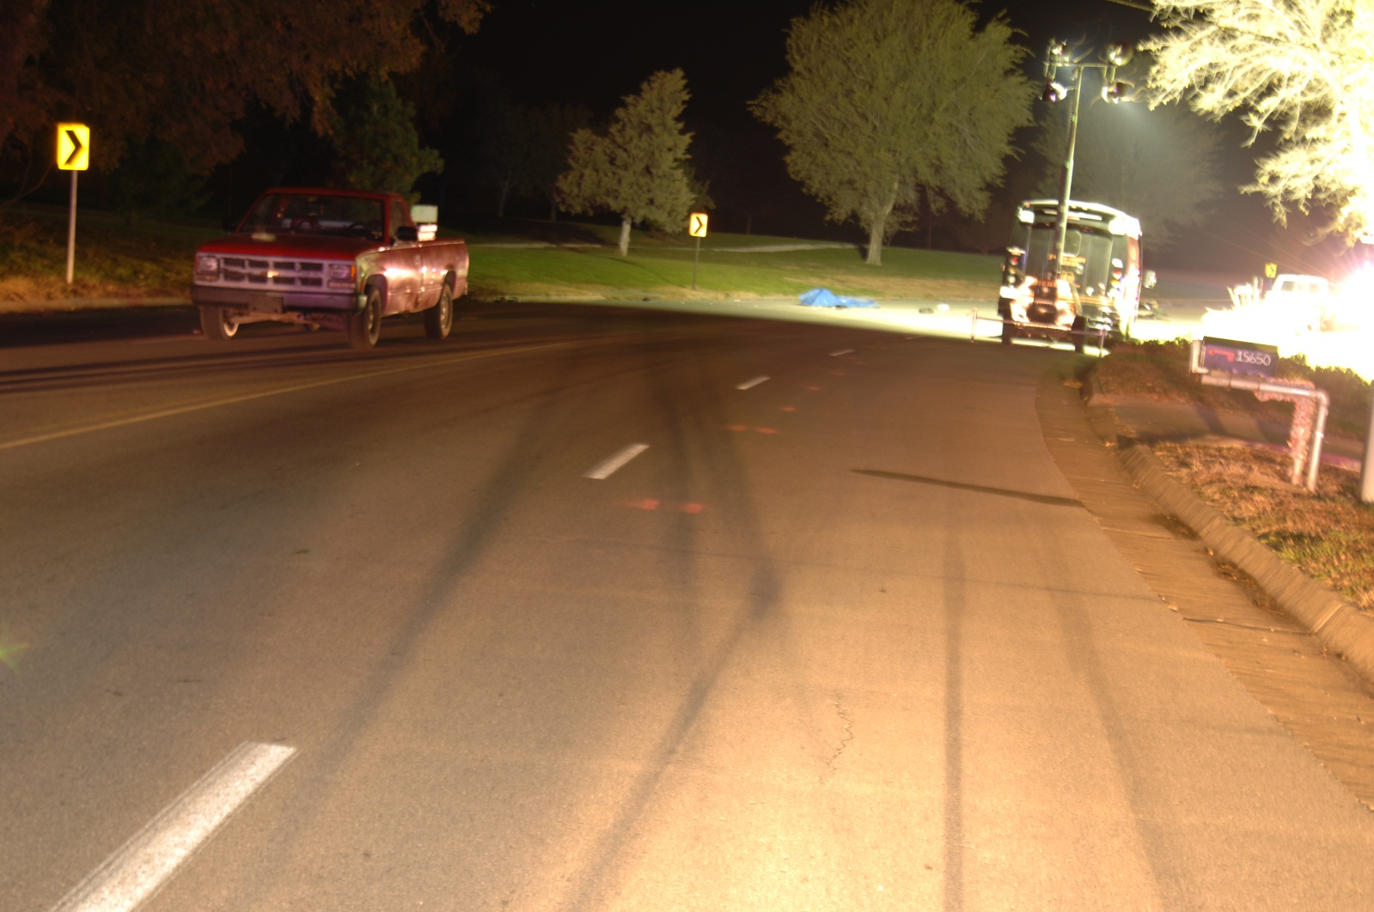
DSC_0005 - Copy

Slide 3
DSC_0005

Slide 4
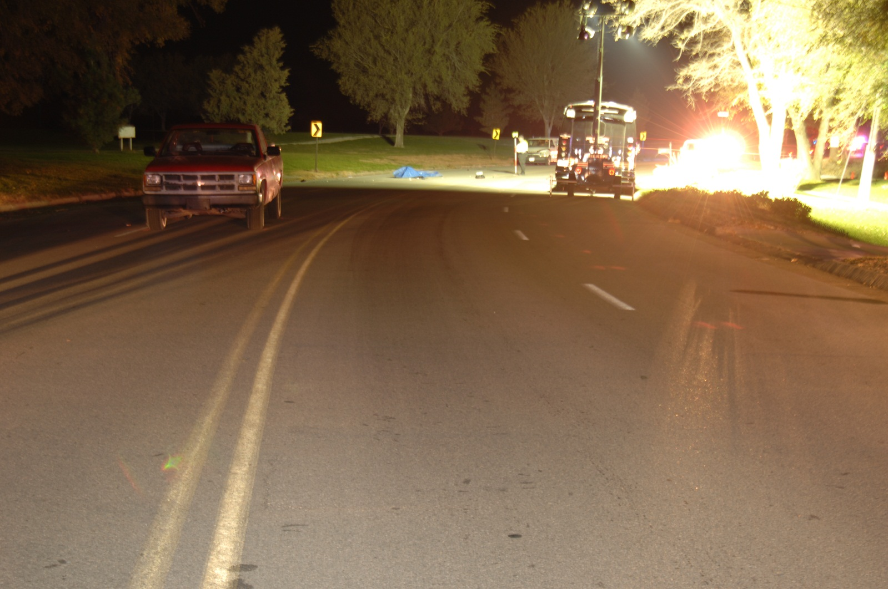
DSC_0006

Slide 5
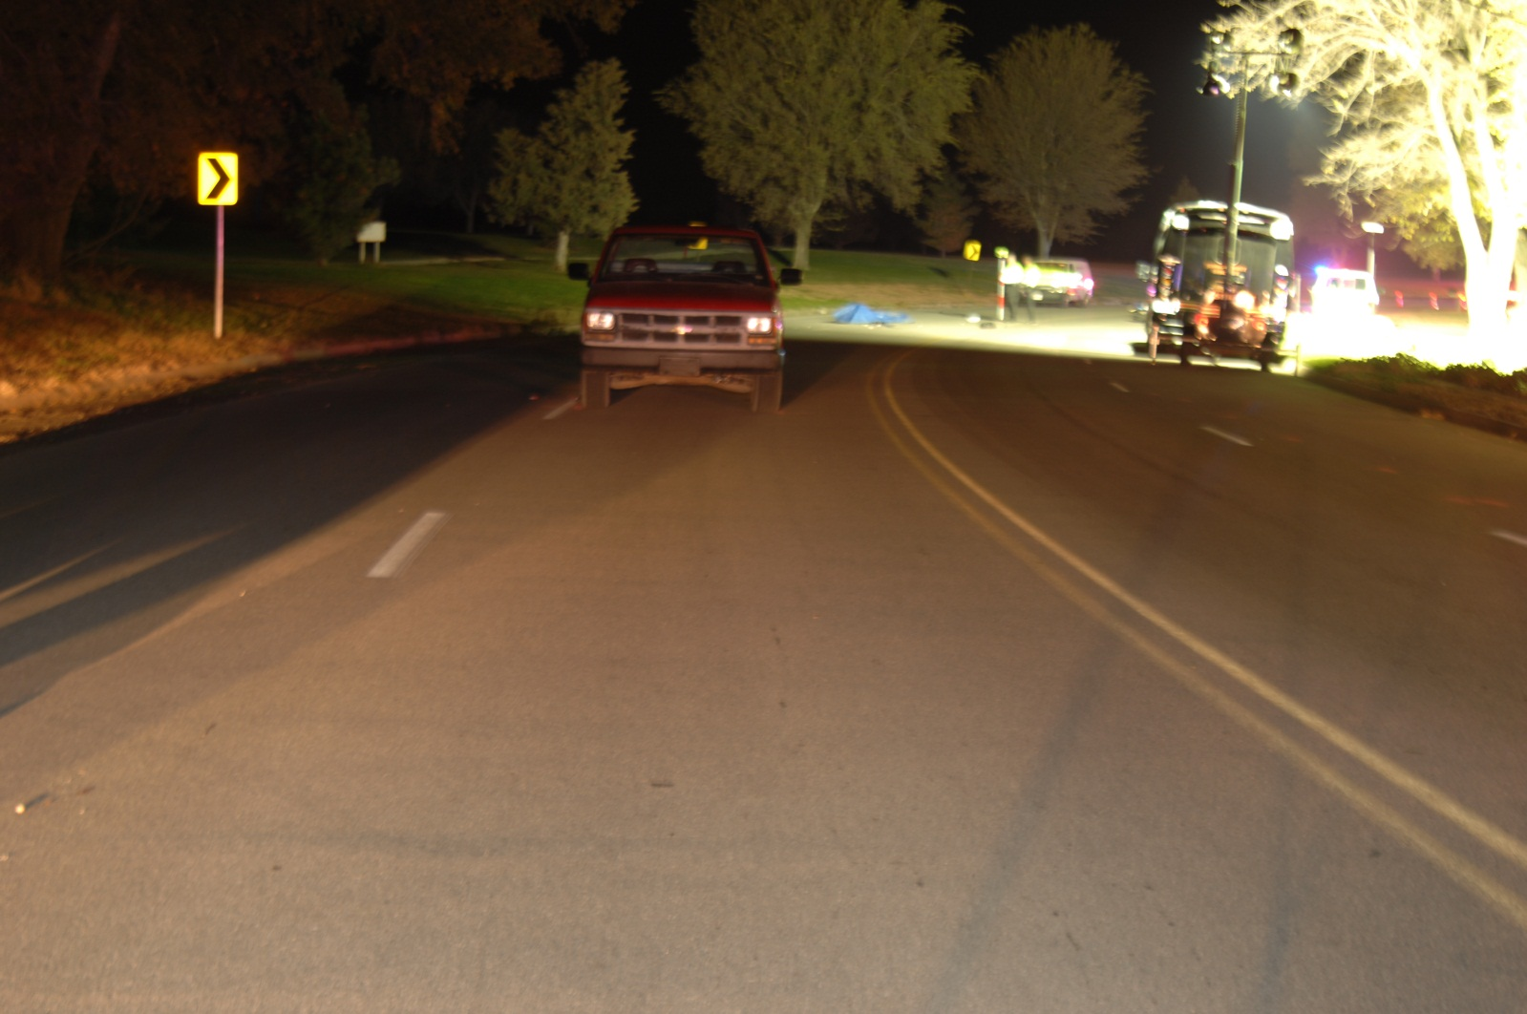
DSC_0007

Slide 6
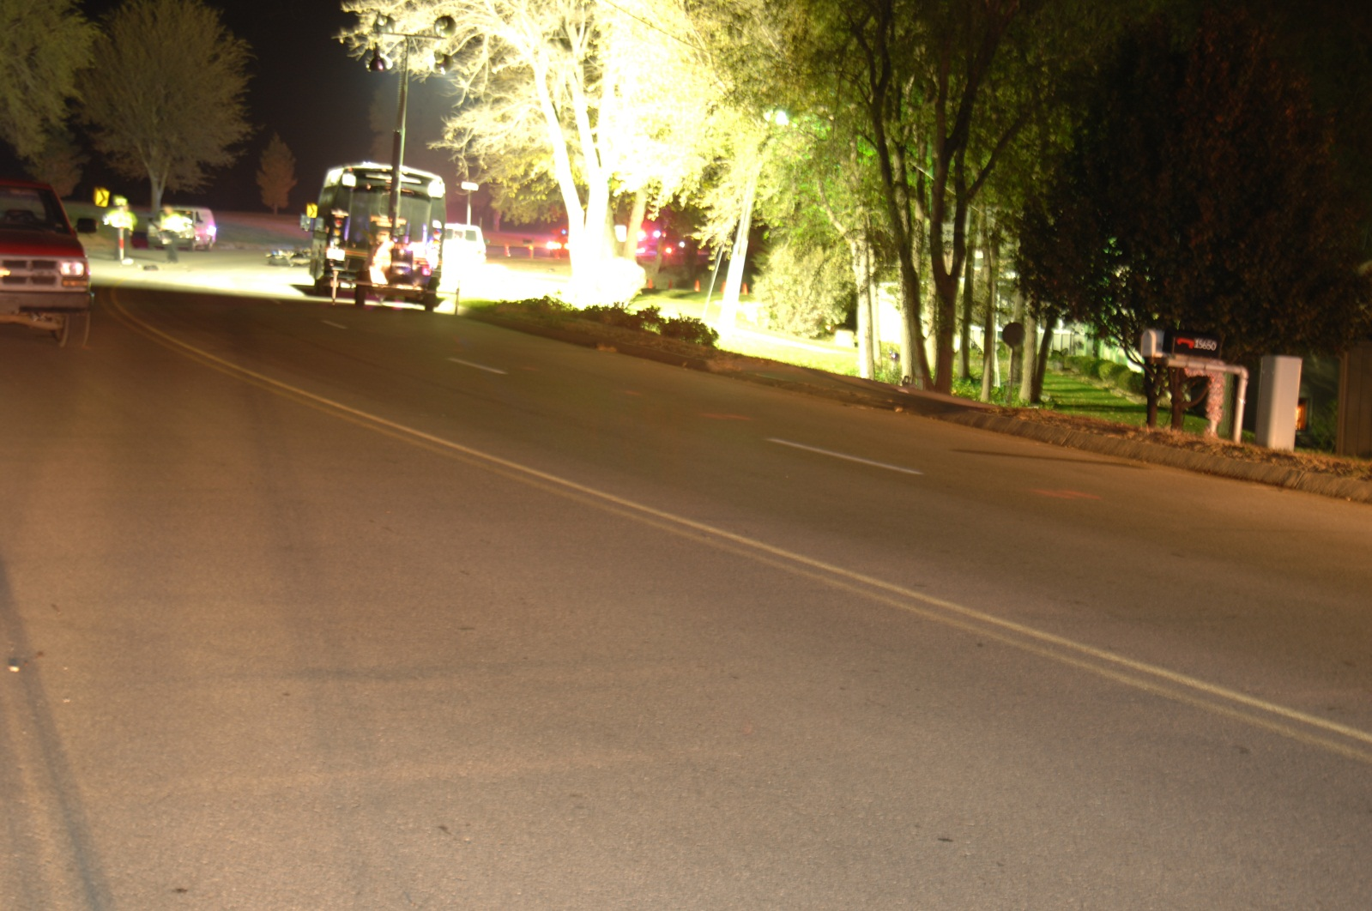
DSC_0008

Slide 7
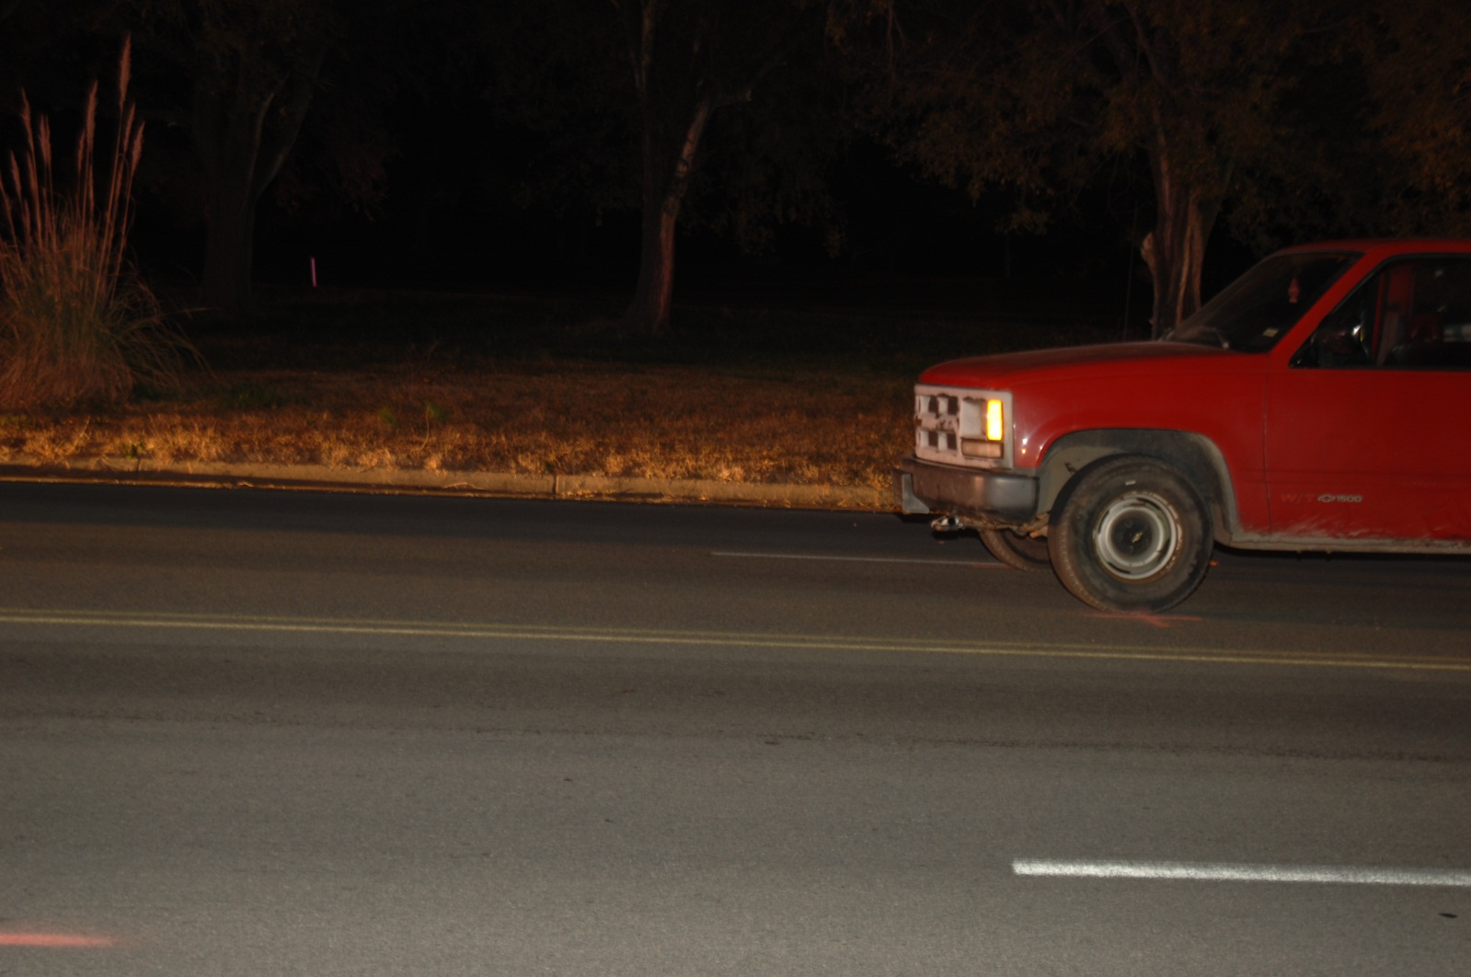
DSC_0009

Slide 8
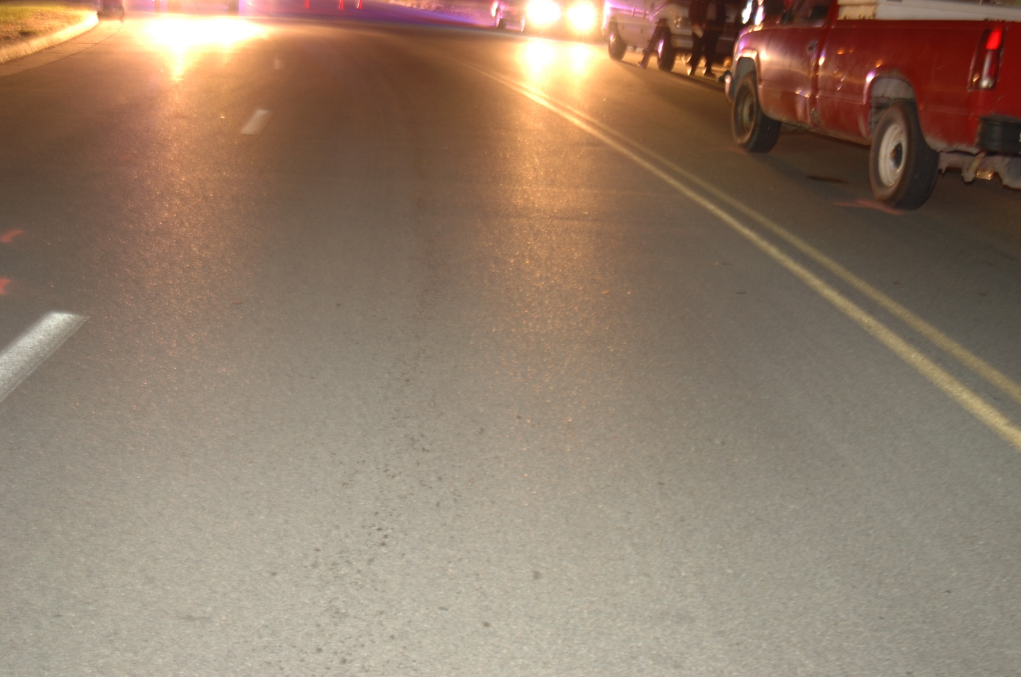
DSC_0010 - Copy

Slide 9
DSC_0010

Slide 10
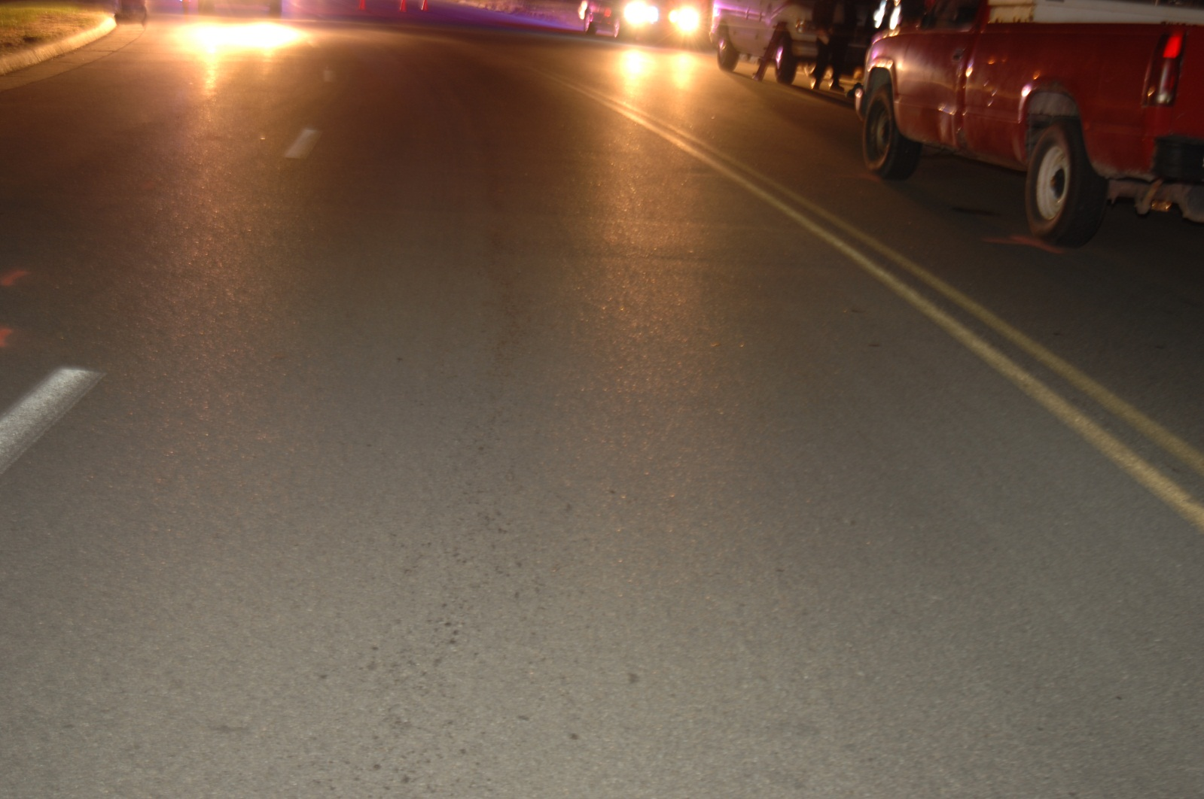
DSC_0011

Slide 11
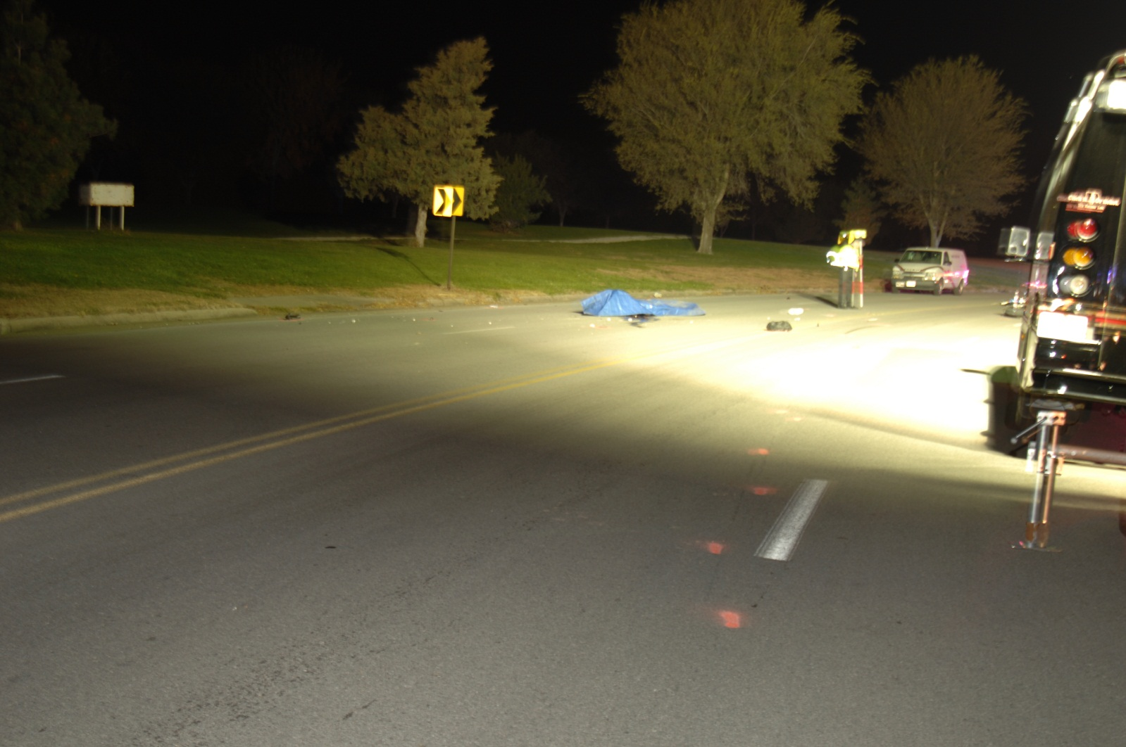
DSC_0012

Slide 12
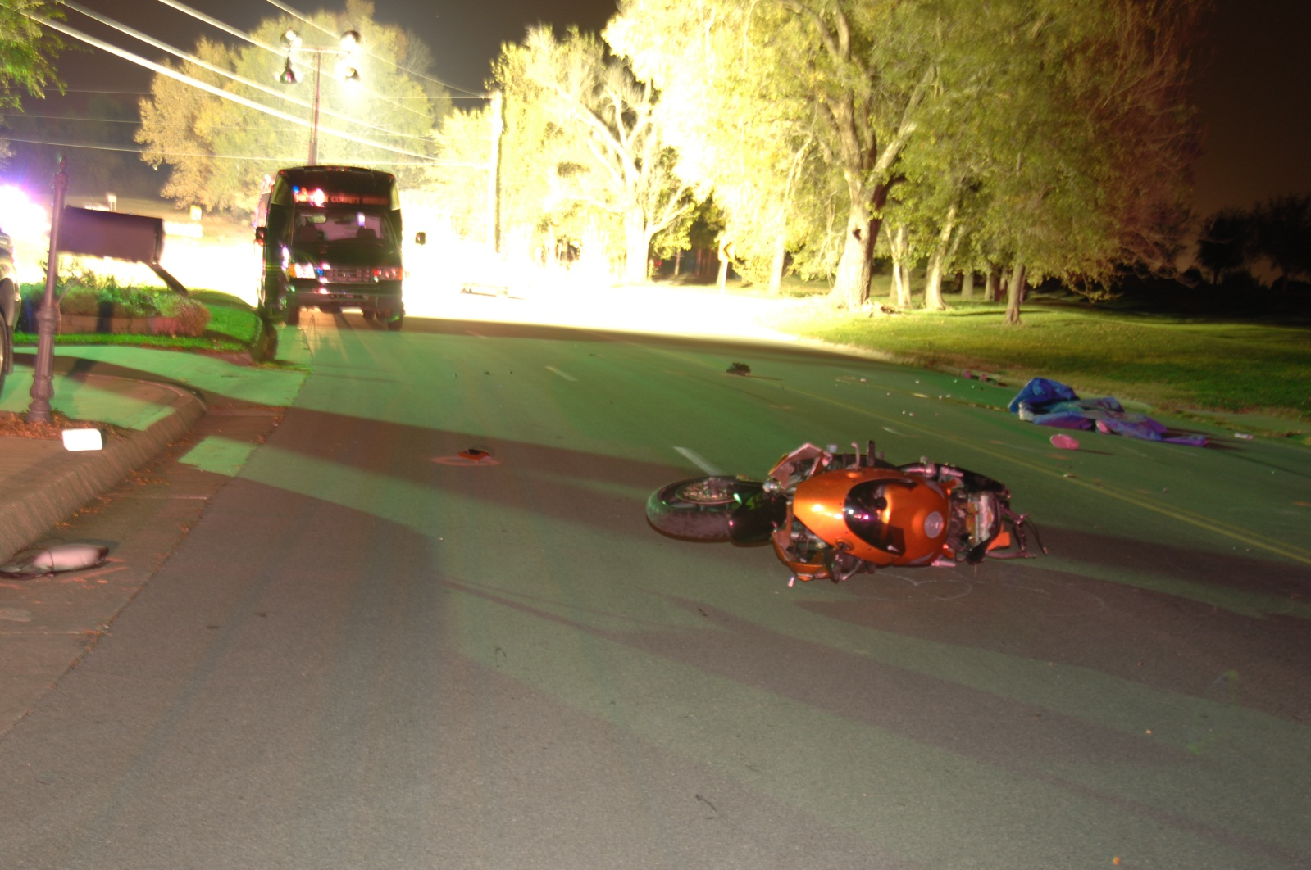
DSC_0013

Slide 13
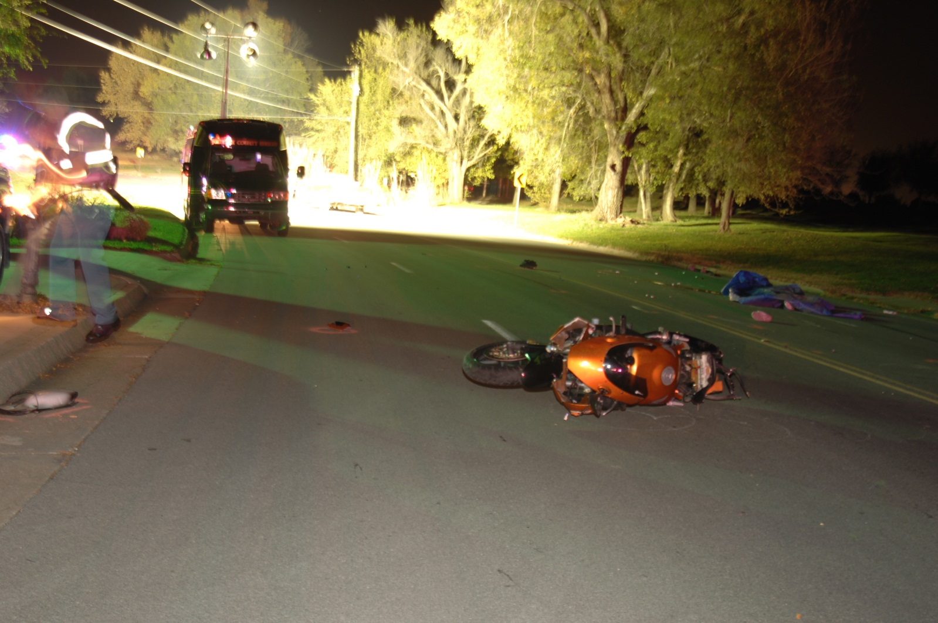
DSC_0014

Slide 14
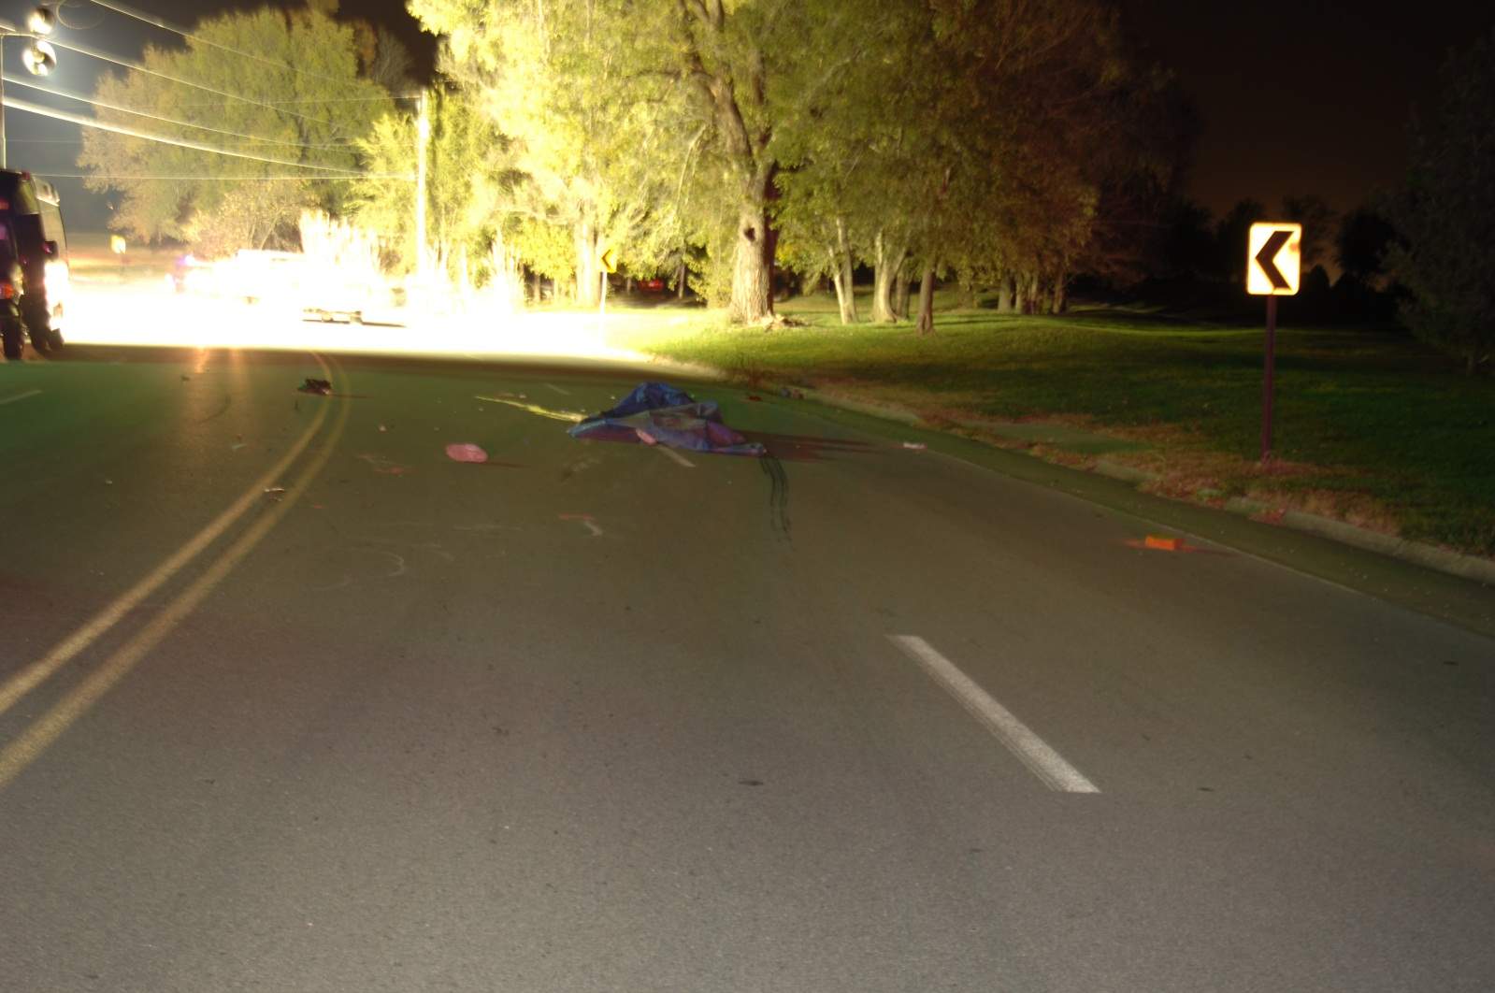
DSC_0015

Slide 15
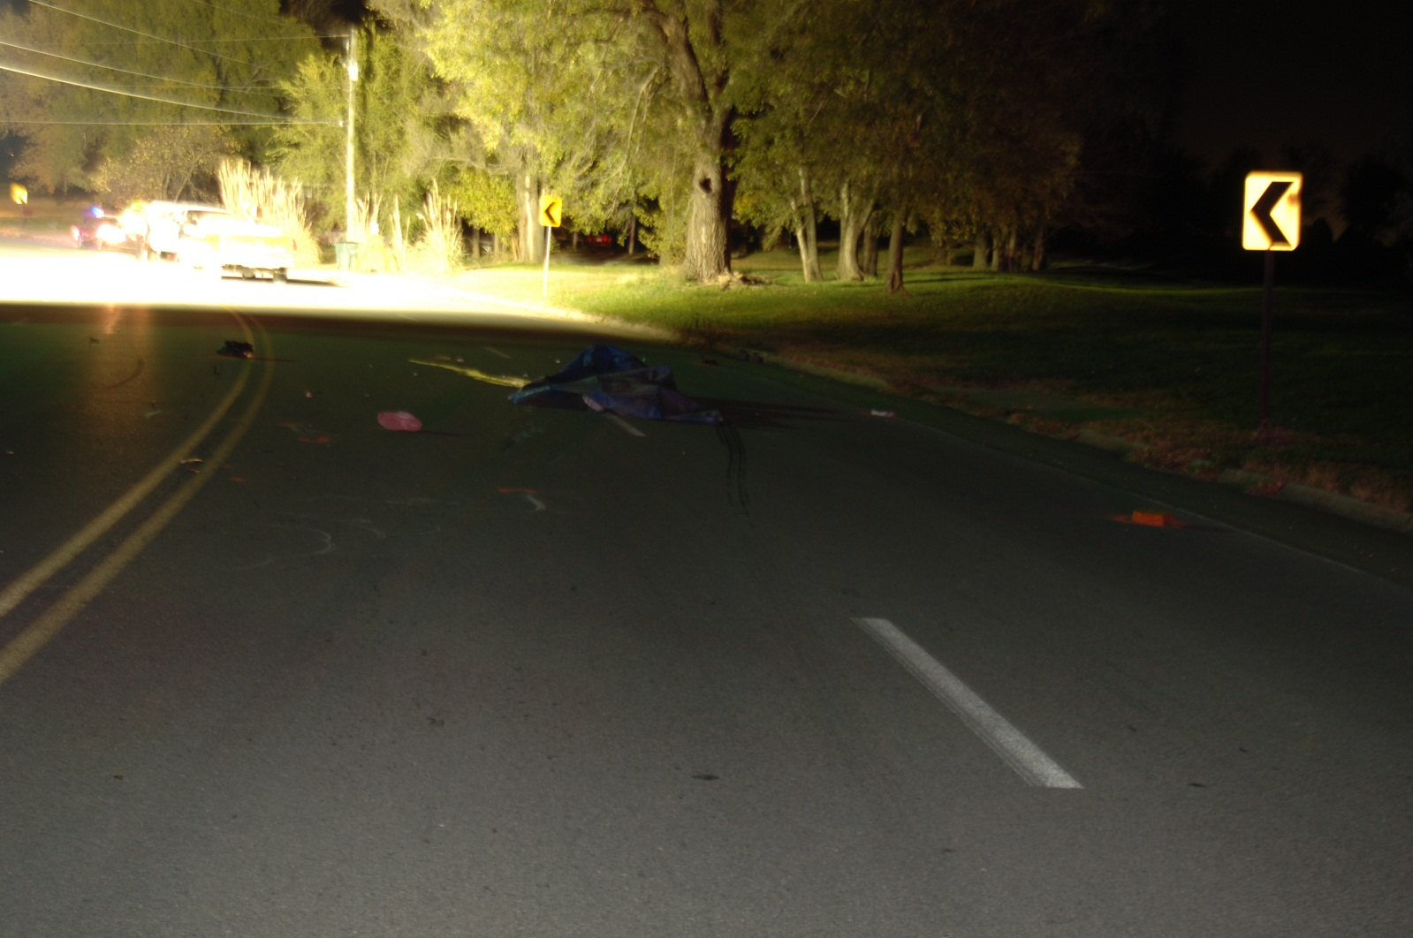
DSC_0016 - Copy - Copy

Slide 16
DSC_0016 - Copy

