Slide 1
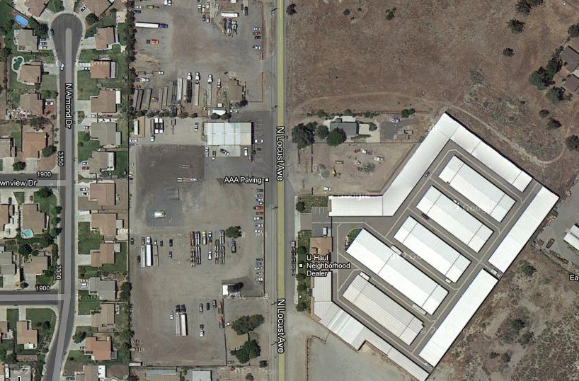

Slide 2
AAA Paving

Slide 3
Uhaul Storage

Slide 4
Rosies House

