Slide 1

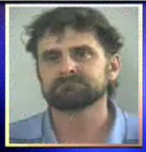
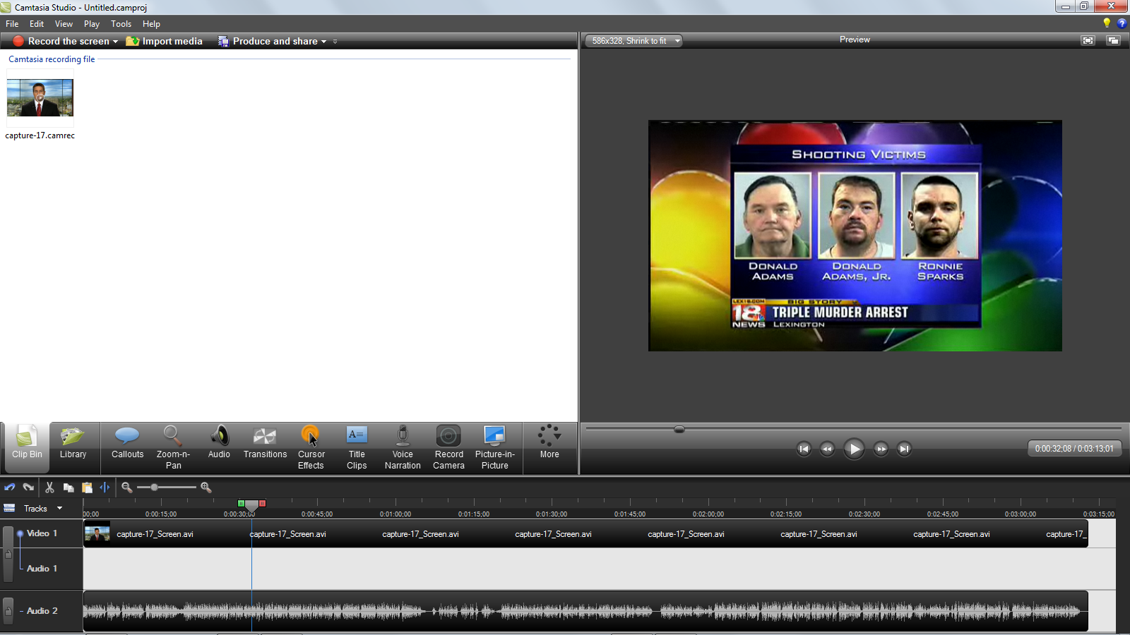

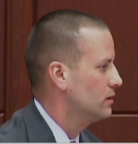
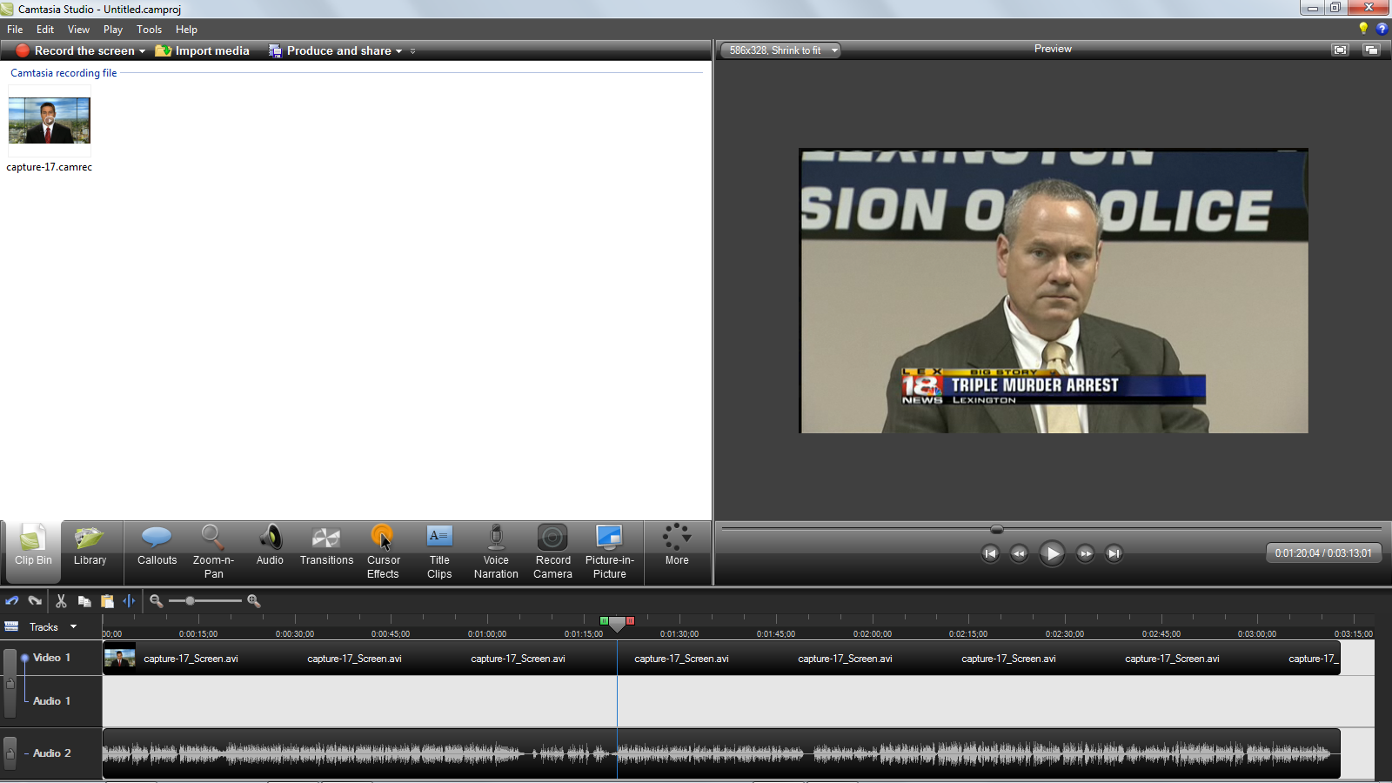
Blancet Triple Homicide Organization Chart
Confidential Source
William Lee “Willie” Blancet, Sr.
Donald L. “Donnie” Adams, Sr.
Christine Jones
William Lee “Willie” Blancet, Jr.
Donald L. “Rocky” Adams, Jr.
Ronald L. Sparks, Jr.
Lexington – Fayette Urban County Police Department
Detective Bill Brislin
Lt. James Cureless

Slide 2
William Lee “Willie” Blancet, Sr.

Slide 3

William Lee Blancet, Jr.
Image Not Available
Son of William Lee “Willie” Blancet, Sr.
At 2169 Shaker Run Road Lexington, KY
  Day of triple homicide

Slide 4
Donald L. “Donnie” Adams, Sr.

Slide 5
Donald L. “Rocky” Adams, Jr.

Slide 6
Ronald L. Sparks, Jr.

Slide 7
Christine Jones
Image Not Available
Ex-wife of Donald L. Adams, Sr.
Mother of Donald L. Adams, Jr.

Slide 8

Detective Bill Brislin
Lexington Police Department
Lead Investigator
Assigned case on….

Slide 9
Lt. James Cureless
Lexington Police Department
Supervisor Investigator
Assigned case on….

